Slide 1



"A PREVENTIVE MEANS TO AN END TO CORONA"

Slide 2
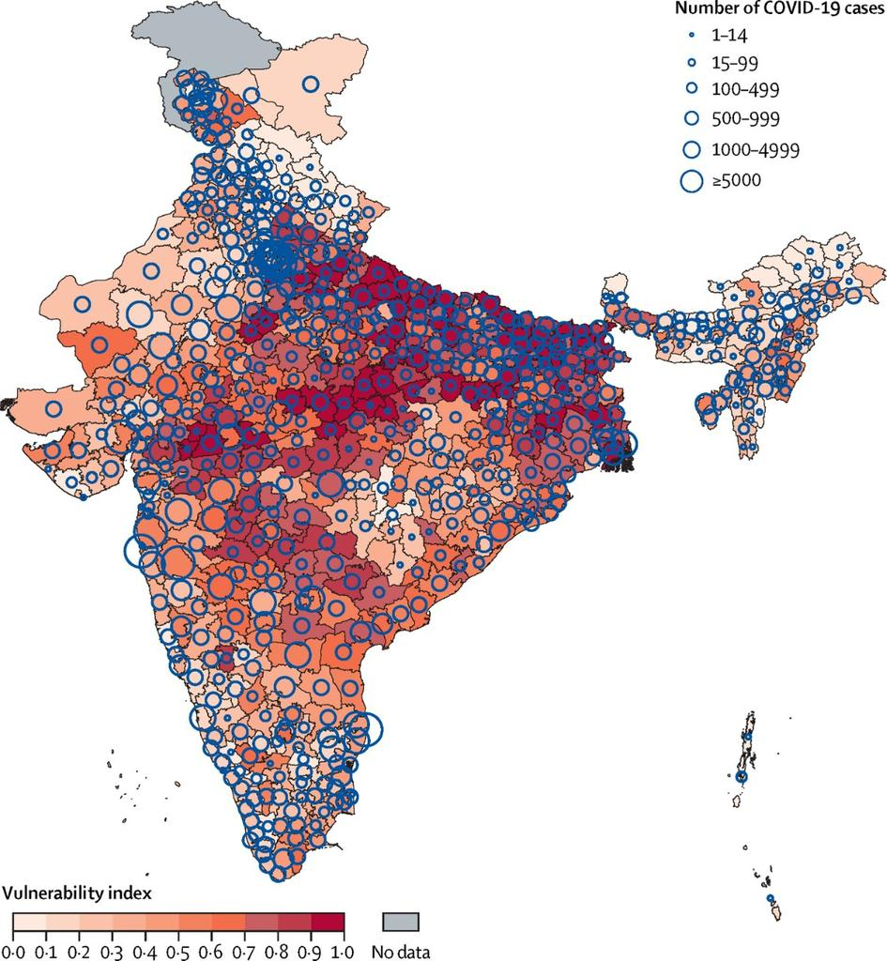
Problem
With such a large population in India it is very difficult for an equitable and fair distribution of the COVID-19 vaccine.
1
According to a report in the Times Of India, it could take upto 2 yrs to provide the vaccine to approx 60% of the population .
2
With the wide dissimilarity in the population demographics and an unequitable distribution of resources among the population it is important that scientific systems are used.
3
Thus it is essential to have an odered fast-paced system for providing the vaccine efficiently and without any prejudice .
4

Slide 3

We are proposing a radically new solution to overcome this problem of distributionof the vaccine as
a government scheme
The Utopia
“Vaccination centres” will have to be created similar to the voting centres to vaccinate people in a particular area.
1
Each person living in the area will have to register themselves on the proposed Nivaran app by
entering various details like name, age, Aadhar card, age, comorbidity, location as well as income
level.
2
The app will then to verify the credentials and will send an otp based on the phone number linked
with the Aadhar card
3

Slide 4
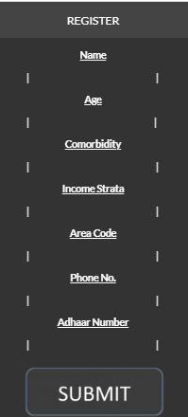
After this the people will be sorted based on their Age, comorbidity, location as well as income
level to select the people who need to be vaccinated on priority. This priority will be based on the
algorithm made.
4
Based on this each person will be sent a QR code along with the date, time and nearest centre.
The person will have to get his QR code scanned at the centre to avail vaccination.
5
After vaccination the person will receive a code which when entered in the app will generate a
certificate that can be used for easy inter territory travel.
6

Slide 5
Current Standing
For the time being we have created a backend algorithm for prioritising the people to be vaccinated.
1
1
It sorts the people based of their Age, Comorbidity, Income strata and Location
2
Due lack of Open Source data that in the future will be provided by the government we have
theorized some conditions and values.
3
For the time being we have created 10 areas which need to be vaccinated marked from 1-10
4

Slide 6
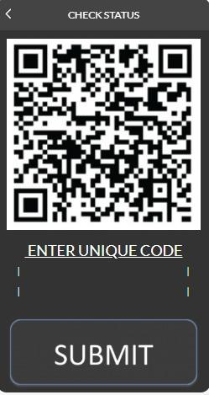
There are 3 main centres of vaccination centre 1 vaccination of areas 1,2,3; centre2 of areas 4,5,6,7
and centre 3 of areas 8,9,10
5
Areas 2,3,7 and 9 are red zones with a high number of COVID 19 patients
6
There are 2 income strata currently taken into account which are APL (above poverty line) and BPL
(below poverty line)
7
For the time being we have created 10 areas which need to be vaccinated marked from 1-10

Slide 7
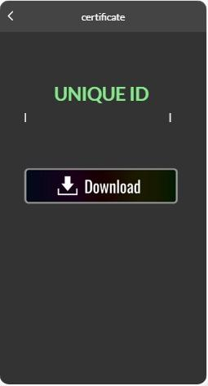
Aspect 1
FUTURE PROPECTS
This idea has the potential to be practically implemented and be scaled up to meet the requirement of the entire nation thus efficiently be used for ultimate “nirvana” from the pandemic.
Aspect 2
With the due permission of the government the Aadhar card shall be linked and will be used for
verification by sending an OTP on the phone number linked with the Aadhar card thus it would help
NIVARAN
Aspect 3
With the data provided by the government we will
automate the task of assigning the centres,
identifying red zones etc.

Slide 8
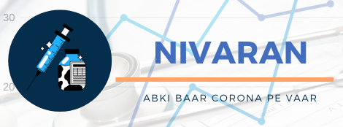
Advantage 1
Advantage 2
Competitive Advantages
Radically new, Efficient and Automated System for the distribution of Covid-19 Vaccine to a large population.
Equitable distribution based on an algorithm that prioritizes age, comorbidity, income etc. based on government guidelines .
Advantage 3
Advantage 4
Prevents unlicensed and illegal supply of covid-19 vaccine as well as various other contraband activities.
It gives a proof of vaccination in the form of a certificate in order to make inter territory travel easy for the person.

Slide 9
